Slide 1



AppBundle
Presented by:
Minxuan Hu
Date : 04/15/2020

Slide 2


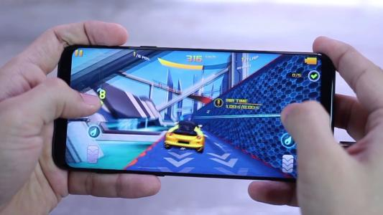
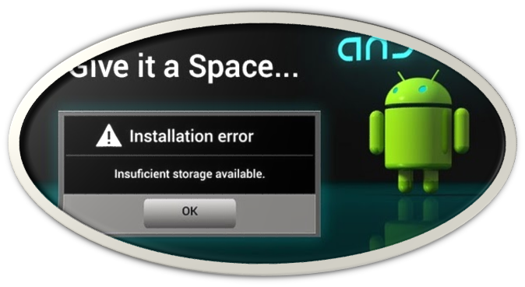


Needs and Customer Segments
Provide the heavy mobile users a simple, fast and reliable storage solution for their applications and data
Mobile Gamers
Mobile Application Development Companies
Inadequate Memory
On-Demand Service
Cost Optimization
Reduced Maintenance
College Students

Slide 3
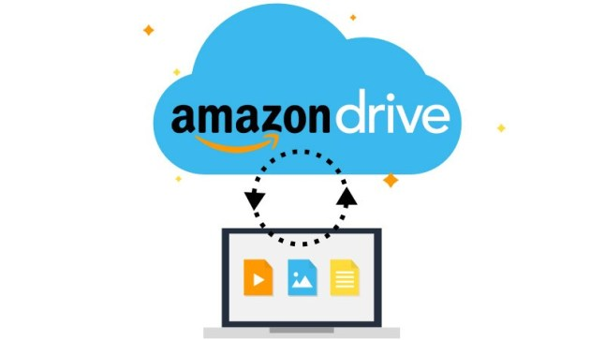




Proposed Solution
The cloud platform is an excellent resource that can keep data safe and available anytime, anywhere. But can these cloud services meet the requirements of users?

Slide 4

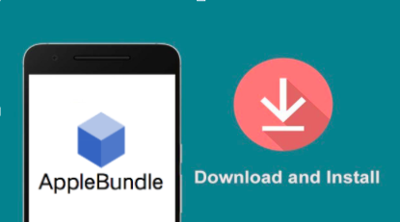
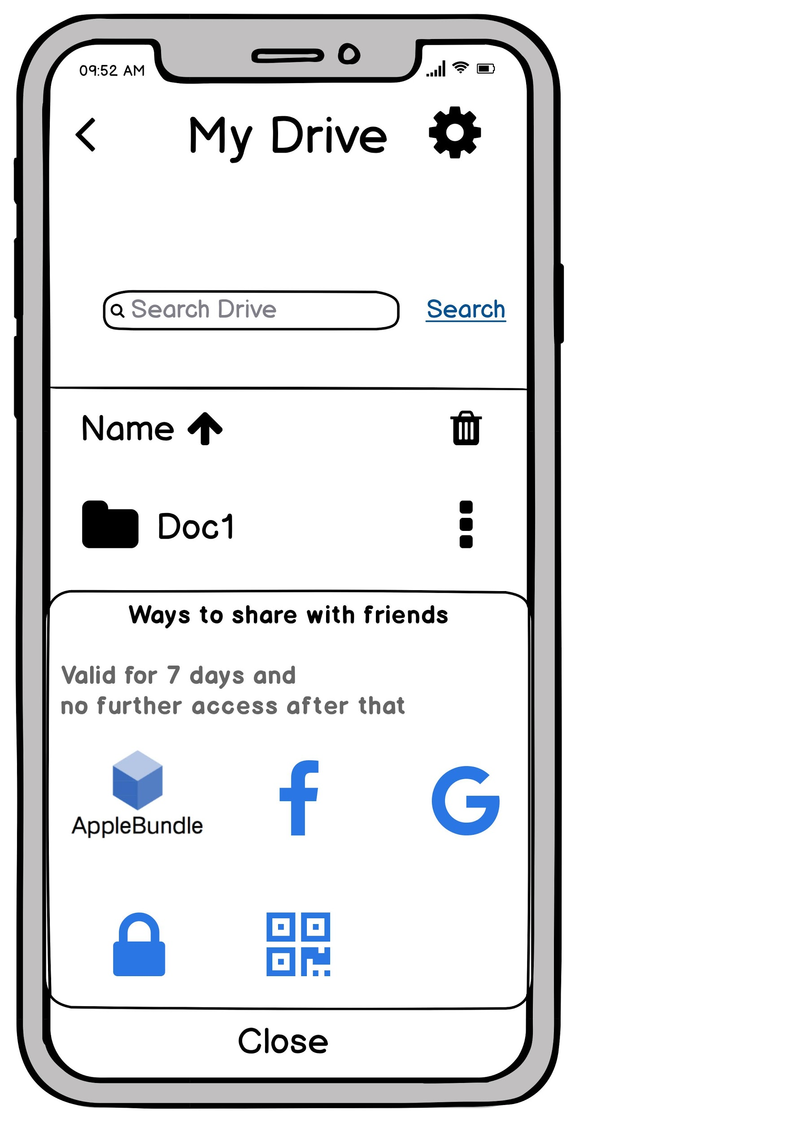
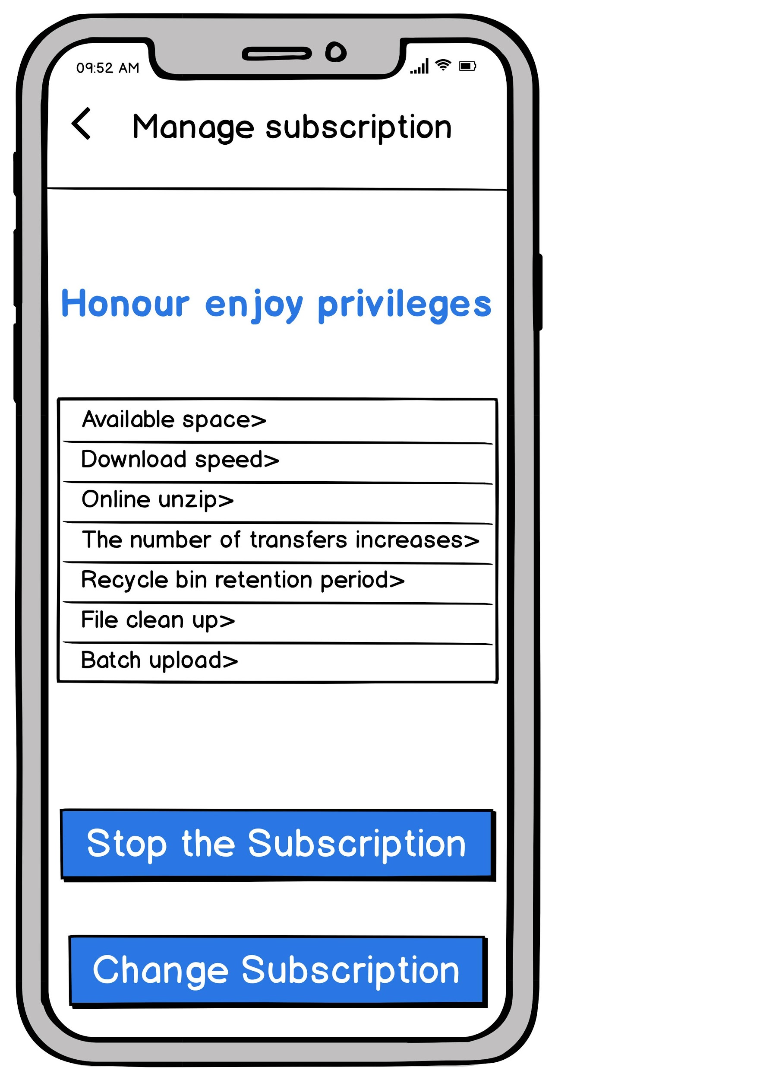
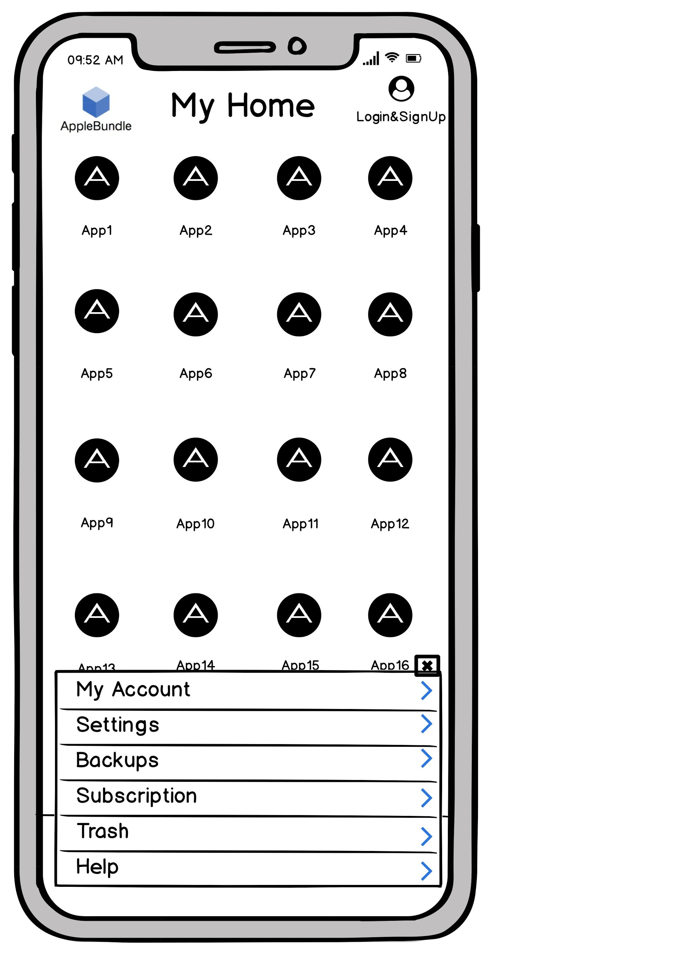
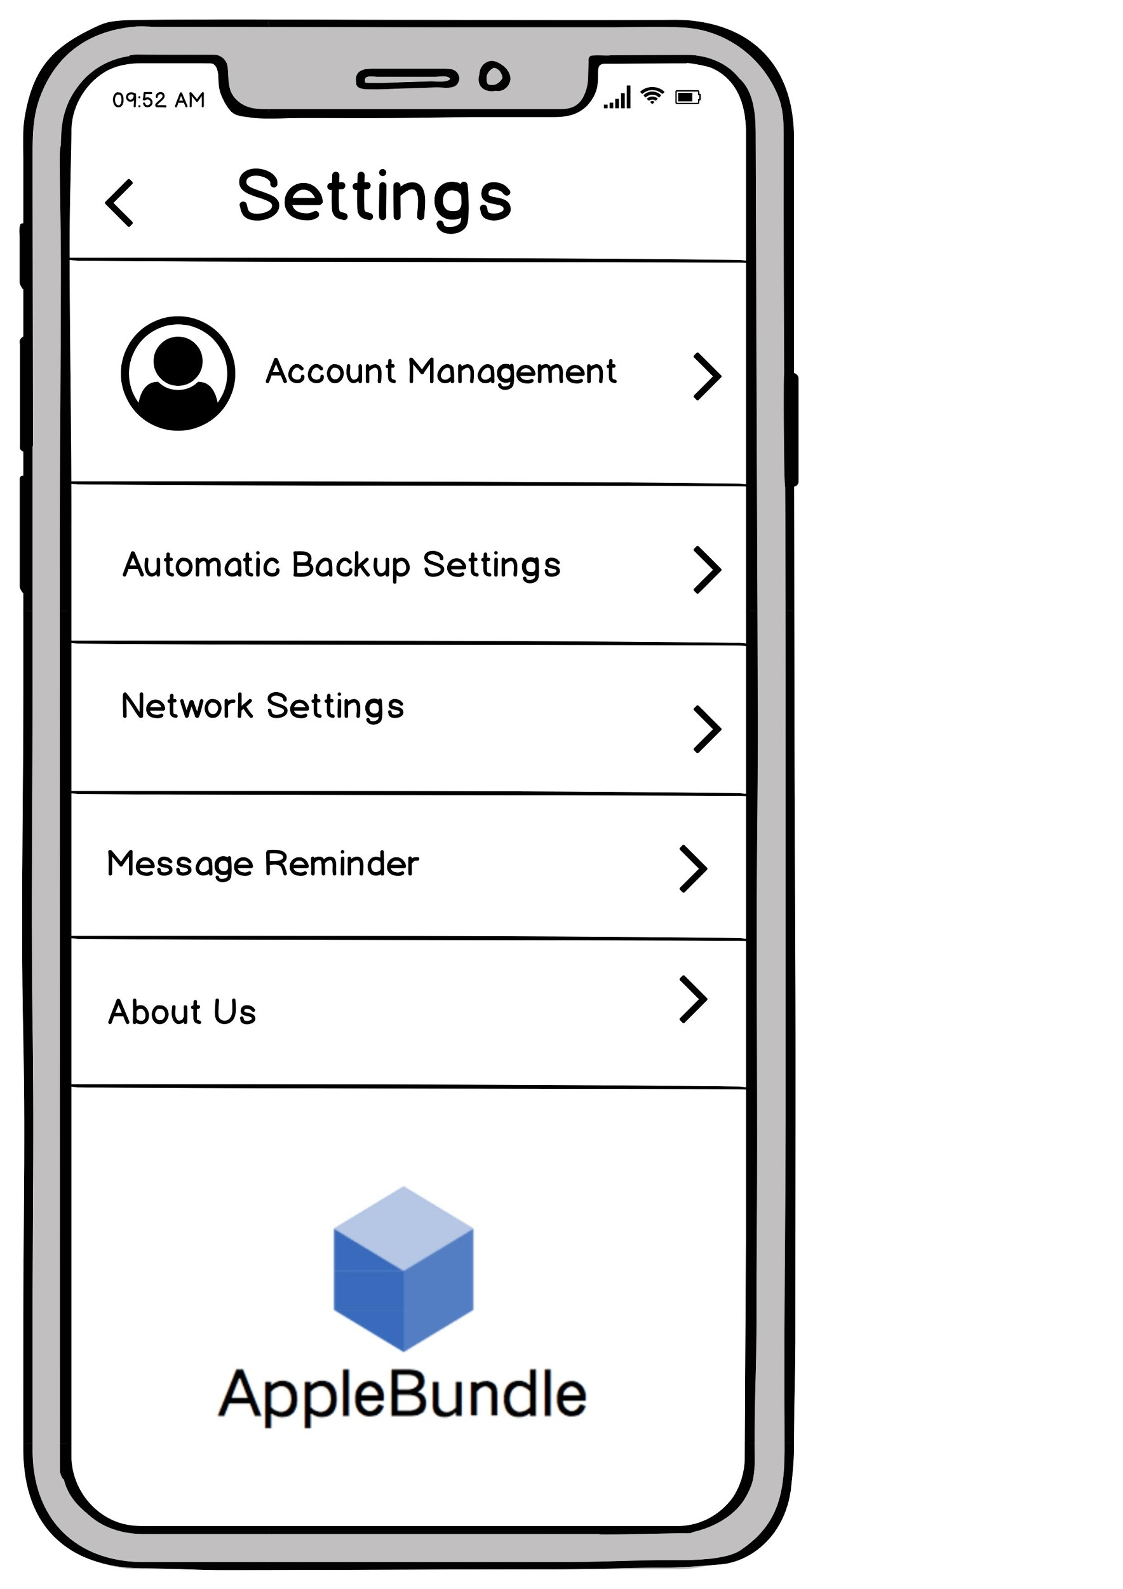
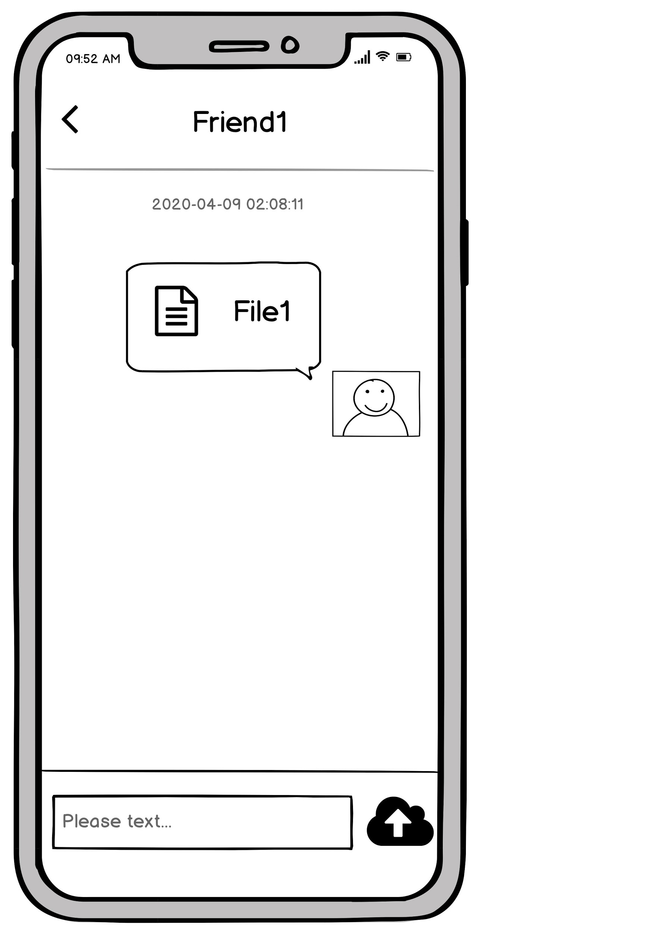
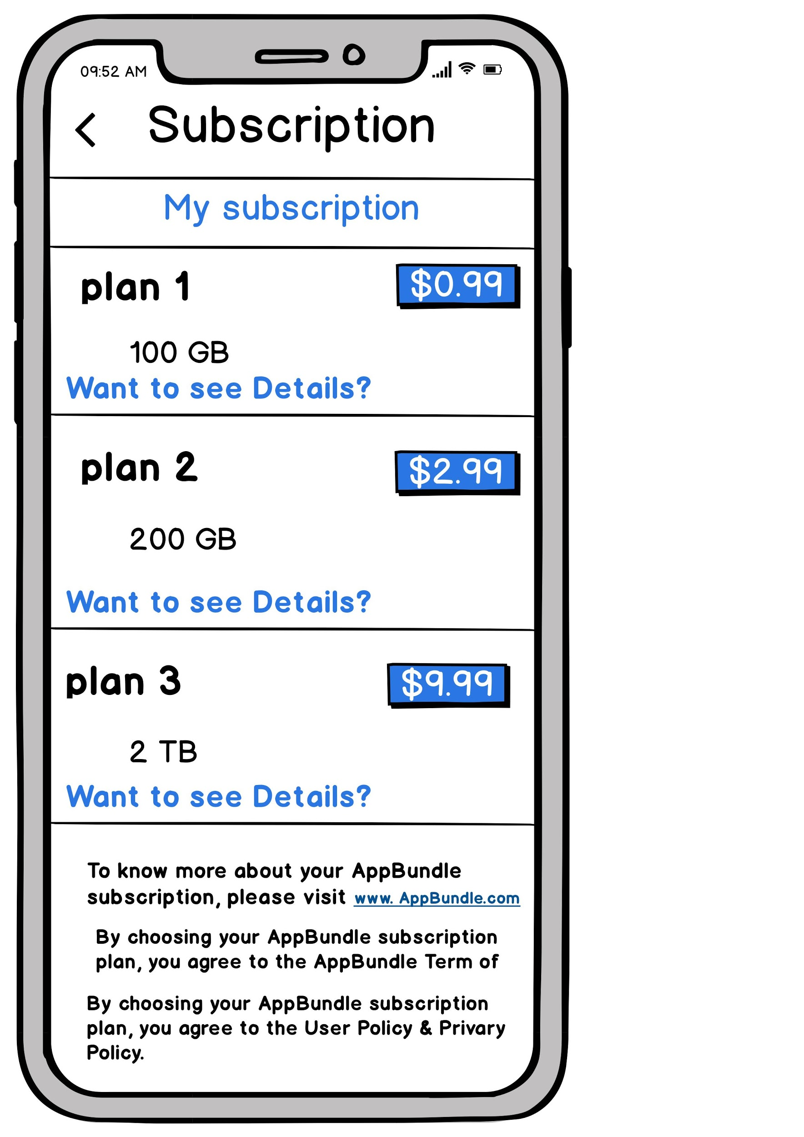
Storyboards & Visual Use Cases
A college student,Sara, who is very sociable and often frustrated by the lack of space on her phone.

Slide 5
Product Roadmap
Themes
Q1
Q2
Q3
Q4
Version
Application Development
Application Testing
Marketing
Customer
Satisfaction
Alpha
Achieve app with full functionality
Zero Bugs with internal testing
Making survey and creating awareness
Link to help
Beta
Develop attractive UI
Testing and Fixing bugs from customer reviews
Secure Market funding
Setup customer helpdesk
Version 2
Implement feature enhancements
Rigorous unit & integration testing
Digital Marketing
Train customer care executives
Version 3
Enhancement with more storage capacity
Setting up ethical hacking team for find bugs.
More third party collaborations
Achieve 100%
Customer satisfaction

Slide 6
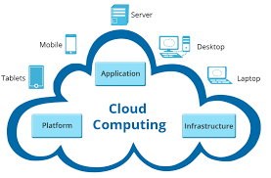
Product Features
Home View | Users can view the home page 1) Login and registration 2) Apps view 3) Icon entries 4) Menu options
Share and chat | Users can share the file and chat
Favorites | Users can search for Apps to add favorites
Settings | Users can make personalized Settings
Backups &Trash | Users can use functions on backups, And clean up space
Subscribe | Users can view plans and subscribe, manage their subscribed plans to change or stop
Help | Users can can choose to chat with customer service, select hot questions and upload files for more

Slide 7
Features of MVP for Launch
Priority 0 – Critical Features Maximum Security
Can create Account and Login AppBundle and edit personal profile Can create and edit payment method (credit card info OR paypal info ) Can view apps ,drives and backups Can share files and chat with friends Can view,subscribe and change or stop plans Can clean up space Can change featured settings Can contact help center
Priority 1 – Nice to have features Minimum latency
Can add, copy, move drives, backups and favorites Can delete and recover files in trash Can add associated account based on contact methods
vNext
Can have multiple subscription plans Can change validity in trash On the go updates with minimum lag
vLongTerm
Intelligent customer service Recommended Apps and Subscription plans Coupon code activity Platform for advertising Community groups

Slide 8

Key Metrics
User Traffic to the application
User adoption
The Network Latency
Capacity of the server
Purchases

Slide 9

Operational Needs
Project manager
Marketing
Developing
Finance
Operation

Slide 10

Projected Cost
Human resources
Project manager($200,000）
Marketing($75,00)
Developing ($90,000)
Finance ($80,000)
Operation ($70,000)
Machine requirement
Laptop (i5, 8 GB RAM) -2
Laptop (i7, 16GB RAM) -3

Slide 11

Addressing Risks
Maintaining Key API’s
Cost Concerns
System Downtime Risk
Security Risks
Features Enhancing Risk
Strategy Planning Risks

